Slide 1

Gender stereotypes about intellectual ability emerge early and influence children’s interests
by Lin Bian, Sarah-Jane Leslie, and Andrei Cimpian
Science
Volume 355(6323):389-391
January 27, 2017
Published by AAAS

Slide 2
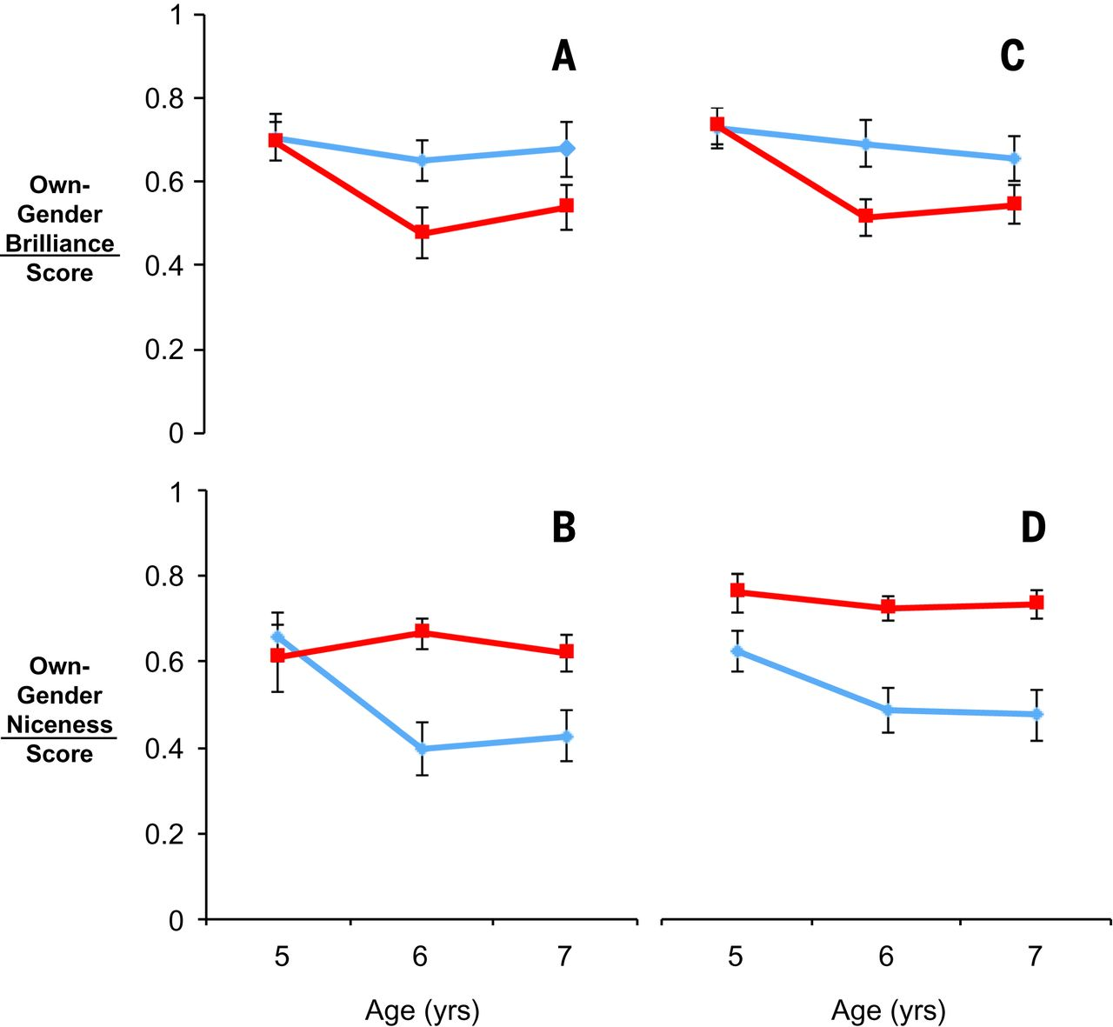
Fig. 1 Results of studies one and two.
Lin Bian et al. Science 2017;355:389-391
Published by AAAS
Notes:
Results of studies one and two. Boys’ (blue) and girls’ (red) stereotype scores in study one (A and B) and study two (C and D), by age group (5- versus 6- versus 7-year-olds). Error bars represent ± 1 SE.

Slide 3
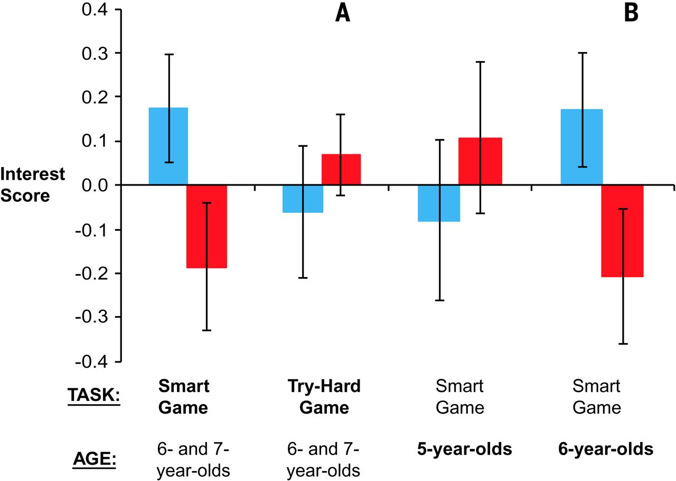
Fig. 2 Results of studies three and four.
Lin Bian et al. Science 2017;355:389-391
Published by AAAS
Notes:
Results of studies three and four. Boys’ (blue) and girls’ (red) interest (average of standardized responses to four questions) in novel games in study three (A) and study four (B). The main independent variable for each study (task in study three, age in study four) is shown in bold. Error bars represent ± 1 SE.

